Slide 1

A PRESENTATION ON CREDIT CARD FRAUD DETECTION PROJECT
Presented By:
Name : Avinandan Bose
Roll No.: 434120010019
Name: Debasish Ghosh
Roll No.:434120010022
Sec/Course: MCA (2020-2022)
Year: 2nd
Semester : 3rd

Slide 2
INDEX
Credit Card Fraud Detection through web app.
Fetch Data From Database
Conclusion
Introduction to Credit Card Fraud
Detection.
Data Analysis
Scaling
Splitting Dataset
Sampling of Imbalance Dataset
MODEL TRAINING
ROC SCORE and ROC CURVE

Slide 3

Introduction to Credit Card Fraud Detection.
Credit Card Fraud occurs when:
a. Un authorized charges to credit card.
b. Counter freight cards used.
c. Credit card details known to others
d. Card Lost or Stolen
Credit Fraud Detection is a machine learning project.

Slide 4
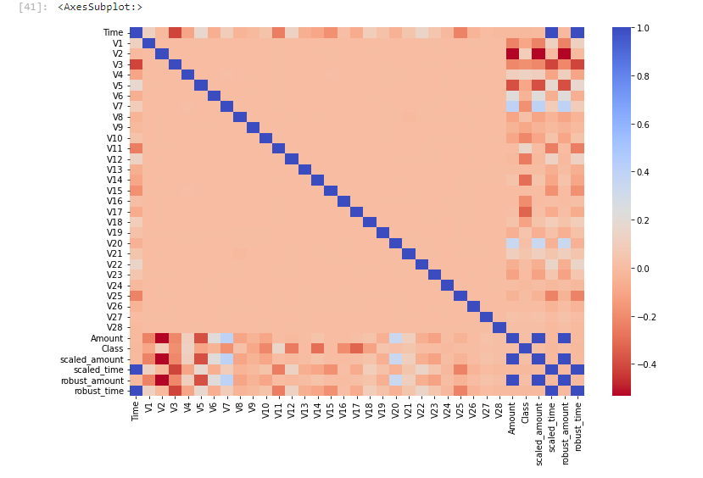
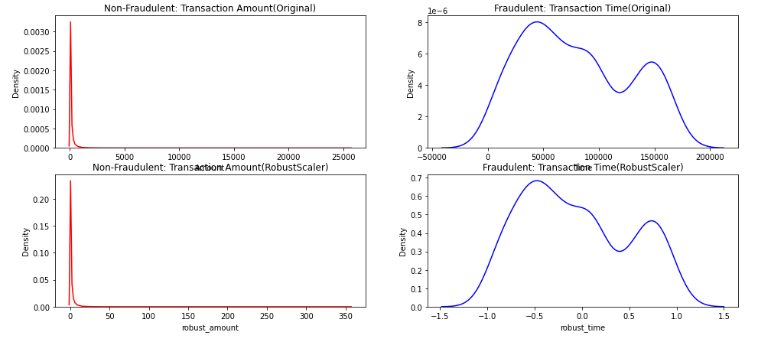
Data Analysis - Scaling
Feature scaling is a method used to normalize the range of independent variables or features of data. In data processing, it is also known as data normalization and is generally performed during the data preprocessing step. In our project we have used ,Standard Scaling, Robust Scaling, Power Transformer , Quantile Transformer and proposed Robust Scaling for our model purpose.

Slide 5
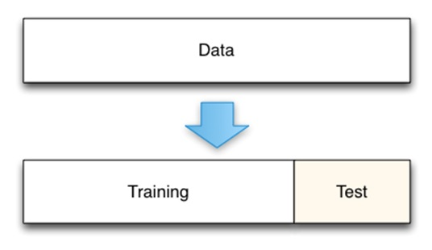
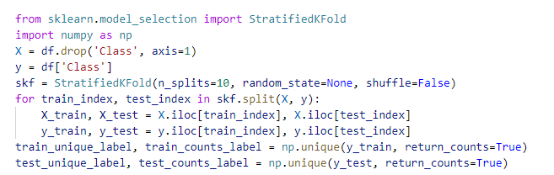
Splitting Dataset
The train-test split is a technique for evaluating the performance of a machine learning algorithm. It can be used for classification or regression problems and can be used for any supervised learning algorithm. The procedure involves taking a dataset and dividing it into two subsets. Here proposed train test splitting is Stratified K-fold technique.

Slide 6
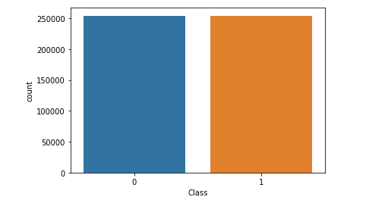
Sampling of Imbalance Dataset
An imbalanced classification problem is an example of a classification problem where the distribution of examples across the known classes is biased or erroneous . Hence we have to make the dataset first balanced before modelling our dataset. Our proposed technique is Synthetic Minority Oversampling Technique or SMOTE.

Slide 7
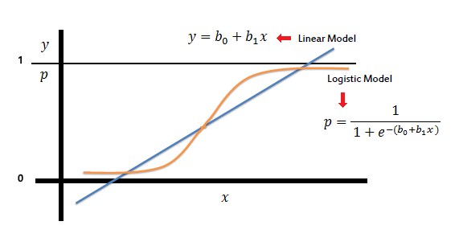
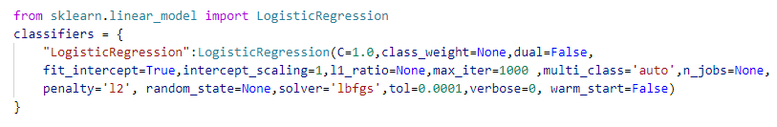
Model Training
A machine learning training model is a process in which a machine learning (ML) algorithm is fed with sufficient training data to learn from. Here among KNN, SVM , DECISION TREE ,LOGISTIC REGRESSION - LOGISTIC REGRESSION have been chosen as best model.

Slide 8
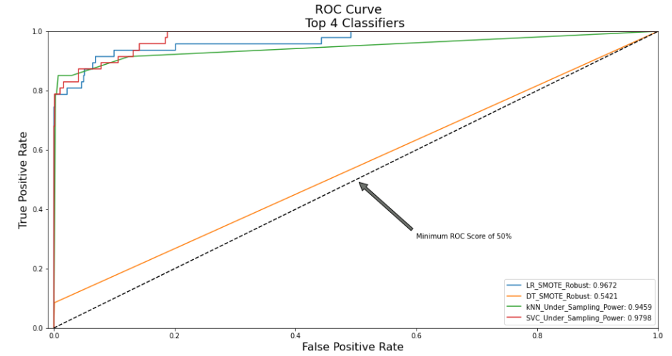
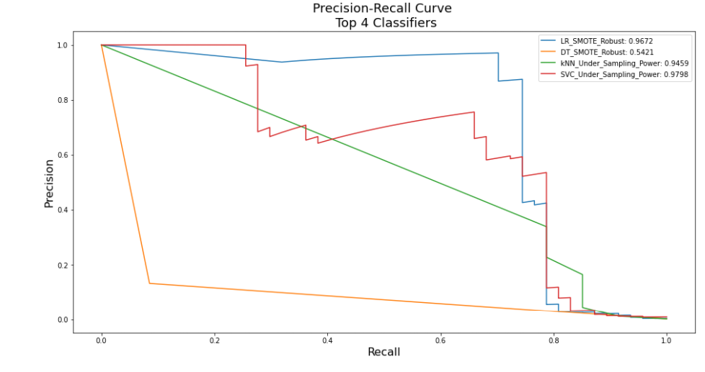
ROC AUC SCORE , ROC CURVE , Precision Curve
ROC Curve is a useful tool when predicting the probability of a binary outcome is the Receiver Operating Characteristic curve, or ROC curve. The area under the ROC curve (AUC) score value lies between 0.5 to 1 , 0.5 denotes bad classifier while 1 denotes excellent classifier. A precision-recall curve is a plot of the precision (y-axis) and the recall (x-axis) for different thresholds, much like the ROC curve.

Slide 9
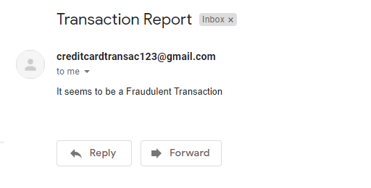
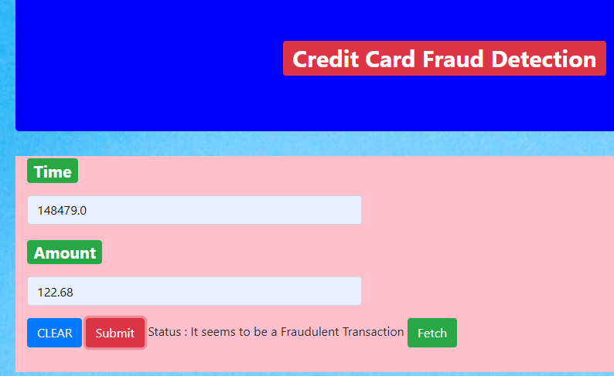
Credit Card Fraud Detection through web app

Slide 10
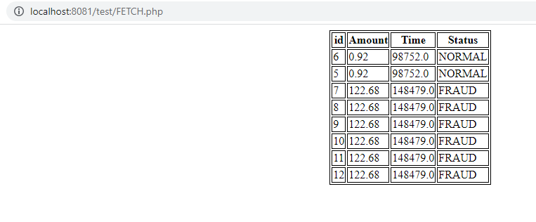
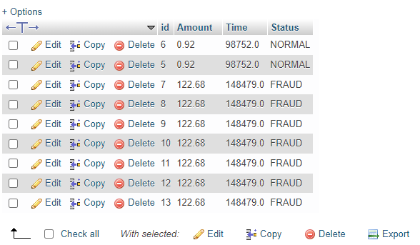
Fetch Data from Database

Slide 11
CONCLUSION
This project help us to deal with large imbalanced dataset.
This project help us to analyze data fraud or not. The exact model will reduce frauds in Credit Card Transaction which is very valuable for financial services , online transactions , ecommerce etc.
-Thank You

